Slide 1
AtliQ Motors
Market study FROM ad-hoc requests
By Sanil Kumar barik
August 31st, 2024

Slide 2
AGENDA
Introduction
Queries
Additional Research and recommendations
Appendix
Gratitude

Slide 3
INTRODUCTION
AtliQ Motors, a leading automotive giant from the USA renowned for its expertise in electric vehicles (EVs), has achieved remarkable success in North America, capturing a 25% market share in the electric and hybrid vehicle segment over the past five years.
In line with their ambitious expansion strategy, the company aims to introduce its bestselling models to the Indian market, where their current share stands at less than 2%.
To ensure a successful market entry, Bruce Haryali, the Chief of AtliQ Motors India, has commissioned a comprehensive market study to understand the dynamics of the EV and hybrid vehicle market in India.
This study will provide crucial insights needed to tailor their approach and capitalize on the growing opportunities in this emerging market.

Slide 4
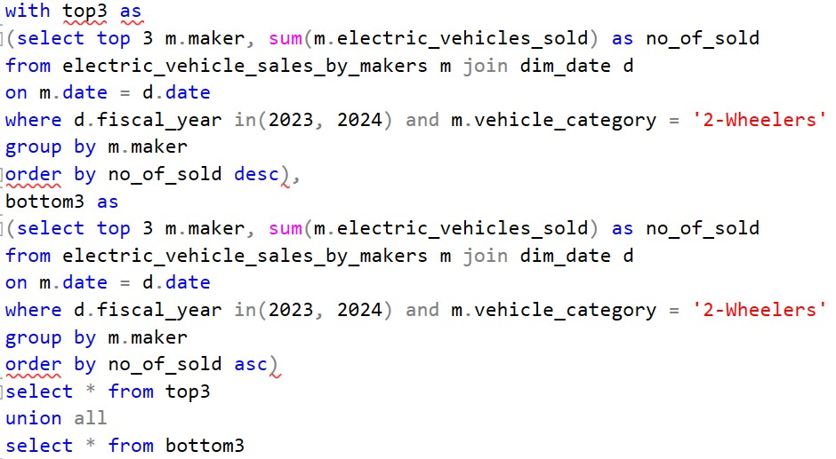
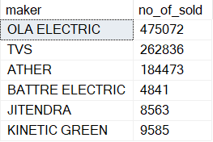
QUERIES
Q1. List the top 3 and bottom 3 makers for the fiscal years 2023 and 2024 in terms of the number of 2-wheelers sold.

Slide 5
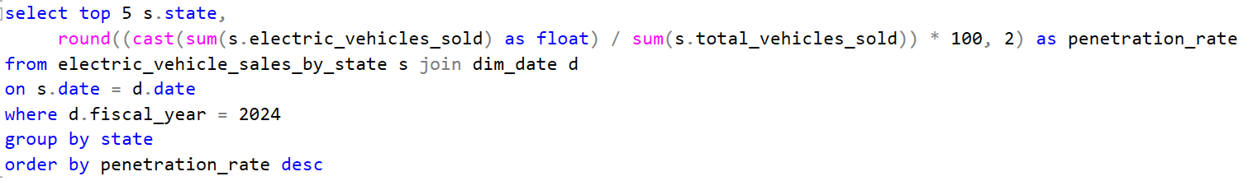
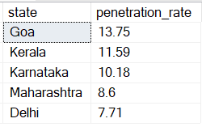
QUERIES
Q2. Identify the top 5 states with the highest penetration rate in 2-wheeler and 4-wheeler EV sales in FY 2024.

Slide 6
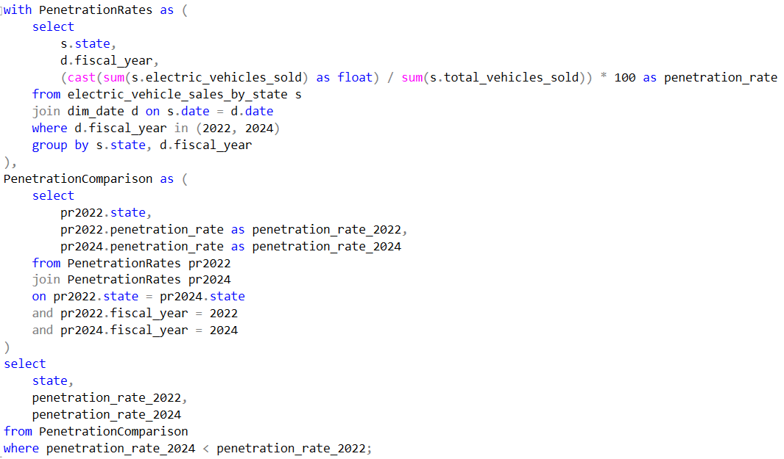
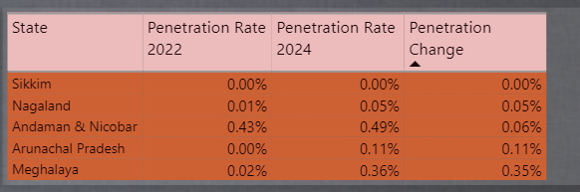
QUERIES
Q3. List the states with negative penetration (decline) in EV sales from 2022 to 2024?

Slide 7
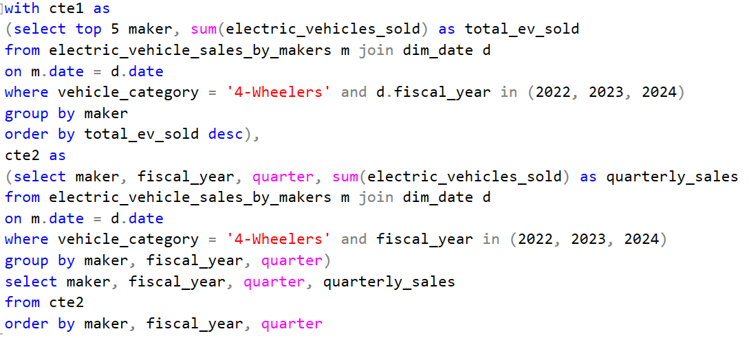
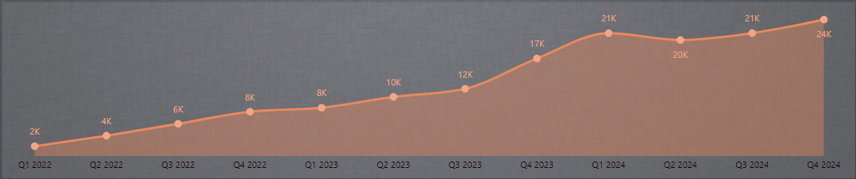
QUERIES
Q4. What are the quarterly trends based on sales volume for the top 5 EV makers (4-wheelers) from 2022 to 2024?

Slide 8
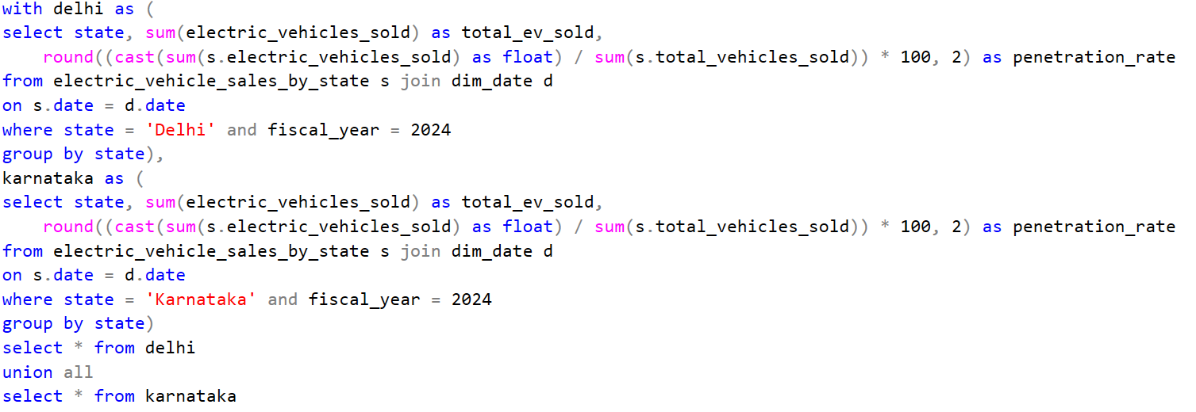

QUERIES
Q5. How do the EV sales and penetration rates in Delhi compare to Karnataka for 2024?

Slide 9
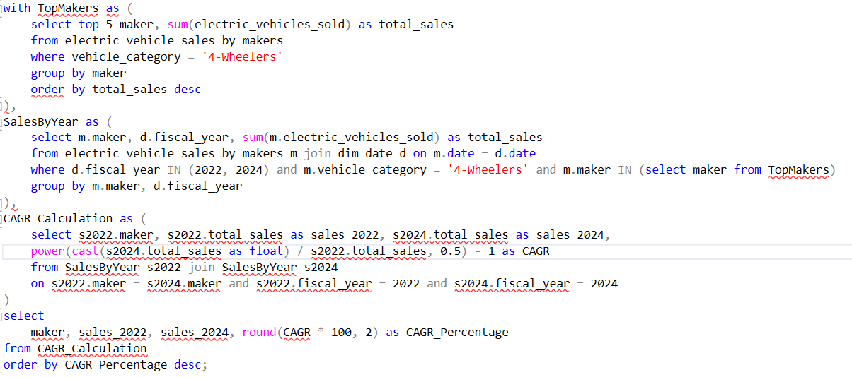
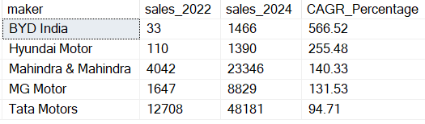
QUERIES
Q6. List down the compounded annual growth rate (CAGR) in 4-wheeler units for the top 5 makers from 2022 to 2024.

Slide 10
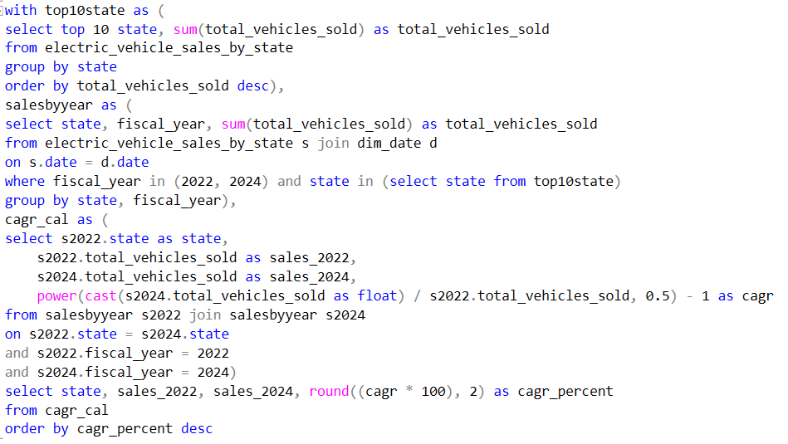
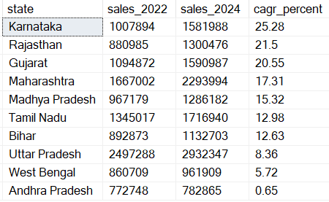
QUERIES
Q7. List down the top 10 states that had the highest compounded annual growth rate (CAGR) from 2022 to 2024 in total vehicles sold.

Slide 11
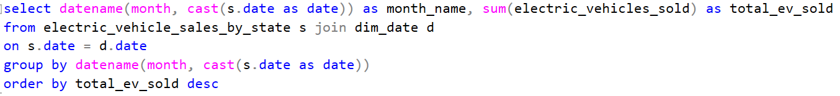
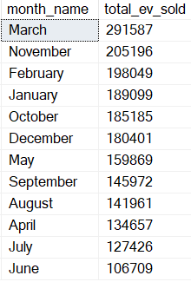
QUERIES
Q8. What are the peak and low season months for EV sales based on the data from 2022 to 2024?

Slide 12
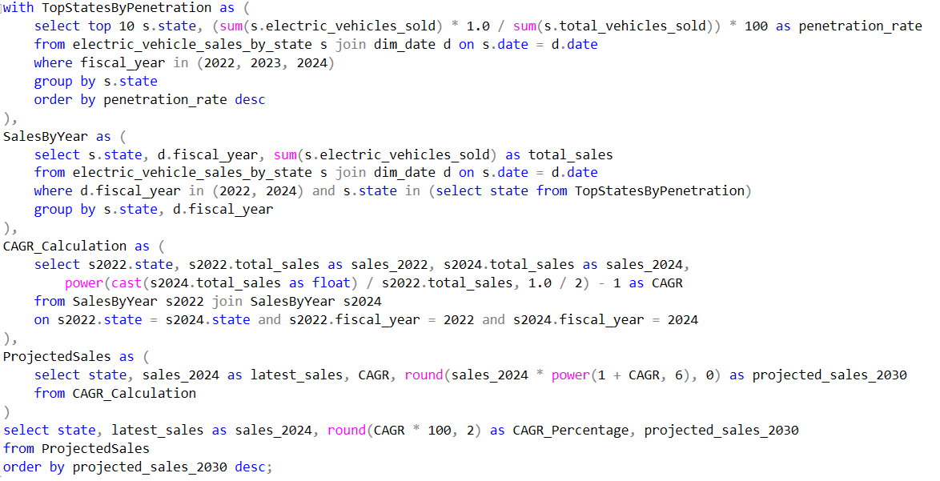
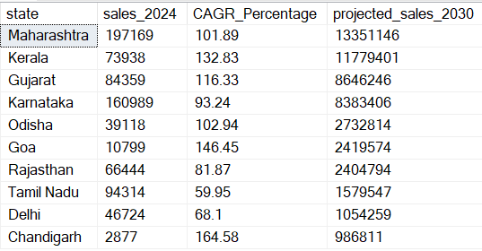
QUERIES
Q9. What is the projected number of EV sales (including 2-wheelers and 4 wheelers) for the top 10 states by penetration rate in 2030, based on the compounded annual growth rate (CAGR) from previous years?

Slide 13
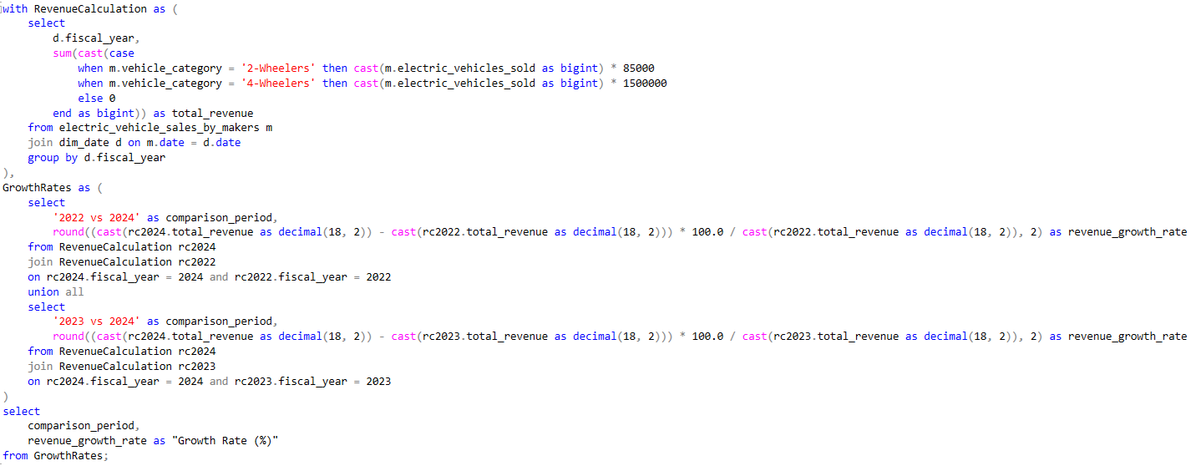

QUERIES
10. Estimate the revenue growth rate of 4-wheeler and 2-wheelers EVs in India for 2022 vs 2024 and 2023 vs 2024, assuming an average unit price. Assume for 2-Wheelers category the average unit price is Rs 85,000.00 and the same for 4-Wheeleres is Rs 15,00,000.00

Slide 14
Additional Research
Q1. What are the primary reasons for customers choosing 4-wheeler EVs in 2023 and 2024 (cost savings, environmental concerns, government incentives)?
In 2023 and 2024, people are choosing 4-wheeler electric vehicles (EVs) mainly because of three key reasons:
1. Saving Money:
- Cheaper to Run: EVs cost less to run than traditional gas or diesel cars. Electricity is usually cheaper than fuel, and EVs need less maintenance because they have fewer parts that can break down.
- Lower Fuel Costs: With fuel prices always changing, the consistent and usually lower cost of electricity makes EVs a smart choice for saving money in the long run.
2. Helping for the Environment:
- Less Pollution: Many people want to reduce their impact on the environment. EVs don’t produce harmful exhaust fumes, which helps lower pollution and fight climate change.
- Going Green: As people become more aware of environmental issues, they’re choosing EVs to support a healthier planet.
3. Government Support:
- Financial Incentives: Governments are offering discounts, tax benefits, and lower registration fees to make EVs more affordable and appealing.
- Better Charging Options: Governments are also investing in more charging stations, making it easier to own and use an EV.
These reasons are driving more people to switch to electric vehicles, and this trend is likely to continue.

Slide 15
Additional Research
Q2. How do government incentives and subsidies impact the adoption rates of 2-wheelers and 4-wheelers? Which states in India provided most subsidies?
Government Incentives and Subsidies Impact on Adoption Rates:
1. Boosting Adoption: Government incentives and subsidies make 2-wheelers and 4-wheelers more affordable, encouraging more people to buy them. When the cost of an electric vehicle (EV) drops due to these benefits, it becomes a more attractive option for consumers.
2. Lowering Upfront Costs: Subsidies help reduce the initial purchase price of EVs, which is often higher than traditional vehicles. This makes EVs more accessible, especially in price-sensitive markets like India.
3. Encouraging Faster Transition: With financial support from the government, more people are willing to switch to EVs sooner, speeding up the overall transition to electric vehicles in the country.
States in India Providing the Most Subsidies:
1. Maharashtra: Offers substantial subsidies for both 2-wheelers and 4-wheelers, along with additional incentives like registration fee waivers and road tax exemptions.
2. Gujarat: Provides significant subsidies for EV purchases and has a strong focus on building EV infrastructure, like charging stations.
These states are leading the way in promoting EV adoption through generous subsidies, making it easier for consumers to make the switch to electric vehicles.

Slide 16
Additional Research
Q3. How does the availability of charging stations infrastructure correlate with the EV sales and penetration rates in the top 5 states?
Correlation Between Charging Infrastructure and EV Sales:
Direct Correlation: The availability of charging stations is strongly linked to higher EV sales and penetration rates. A robust charging network alleviates concerns about running out of battery, making EVs a more viable option for daily and long-distance use.
Increased Convenience: A well-distributed network of charging stations, including fast chargers, adds convenience for EV owners. This ease of access encourages more people to consider EVs, knowing they won’t face difficulties in finding a charging point when needed.
Urban vs. Rural Penetration: In states where charging infrastructure is concentrated in urban areas, EV adoption is higher in cities. Conversely, the lack of infrastructure in rural areas slows down EV penetration, highlighting the need for more widespread deployment.
Positive Feedback Loop: As more people buy EVs, demand for charging infrastructure increases, leading to further expansion of the network. This creates a positive cycle where better infrastructure drives more sales, which in turn encourages further investment in charging stations.
Government and Private Sector Role: In states with high EV sales, both government initiatives and private investments play a crucial role in building and maintaining the charging infrastructure. This collaboration accelerates the growth of the EV market.
More stations lead to higher EV adoption, showing a clear link between infrastructure and market penetration.

Slide 17
Additional Research
Q4. Who should be the brand ambassador if AtliQ Motors launches their EV/Hybrid vehicles in India and why?
Choosing the right brand ambassador for AtliQ Motors' EV/Hybrid vehicle launch in India is important for reaching the right audience and building a strong brand image. Here are some potential candidates and the reasons why they could be a good fit:
1. Sunita Narain (Environmental Activist):
- Environmental Advocacy: Sunita Narain is a well-known environmental activist in India, deeply involved in sustainable development and advocating for clean energy, including electric vehicles.
- Credibility in Environmental Circles: Her endorsement would add serious credibility to AtliQ Motors' environmental goals, aligning the brand with broader eco-friendly movements.
- Public Awareness and Education: As someone who has been instrumental in raising awareness about environmental issues, Narain could help position AtliQ Motors as a leader in sustainable transport.
2. Vandana Shiva (Environmental Activist):
- Advocate for Sustainability: Vandana Shiva is a renowned environmental activist known for her advocacy on sustainability, biodiversity, and eco-friendly practices.
- Strong Environmental Credentials: Her longstanding commitment to environmental causes makes her an ideal spokesperson for AtliQ Motors, reinforcing the company’s commitment to green technology.
- Public Awareness and Global Recognition: Vandana Shiva’s global recognition as an environmental leader would bring significant credibility to AtliQ Motors’ mission to promote electric vehicles as a sustainable choice.
These two Environmental Activists could be great choice for AtliQ Motors to make Brand Ambassadors.

Slide 18
Additional Research
Q5. Which state of India is ideal to start the manufacturing unit? (Based on subsidies provided, ease of doing business, stability in governance etc.)
To choose the ideal state for AtliQ Motors' manufacturing unit in India, consider the following factors:
1. Subsidies and Incentives: States like Gujarat, Maharashtra, and Karnataka offer significant subsidies and incentives for EV and automotive manufacturing.
2. Ease of Doing Business: Gujarat and Karnataka are known for their favorable business environments and streamlined processes.
3. Infrastructure: States such as Tamil Nadu and Gujarat have well-developed infrastructure, including transport and logistics.
4. Governance Stability: Gujarat and Karnataka are known for stable governance and proactive support for industrial development.
5. Market Access: States like Maharashtra and Gujarat provide better access to major urban markets, which can be advantageous for distribution and sales.
6. Proximity to Supply Chain: Gujarat and Maharashtra are well-connected to major automotive parts suppliers and logistics networks, which can reduce costs and improve efficiency.
Based on these criteria, Gujarat often emerges as a top choice due to its robust infrastructure, favorable business environment, and strong government support for manufacturing industries.

Slide 19
Additional Research
6. My top 3 recommendations for AtliQ Motors.
Based on the problem statement and the task at hand, here are my three recommendations for AtliQ Motors to successfully launch their bestselling EV models in India:
1. Conduct an honest Market Segmentation Analysis:
- Recommendation: Analyze the Indian EV market to understand different customer segments, their preferences, and buying behavior. Focus on factors such as income levels, urban vs. rural preferences, and regional variations.
- Reasoning: This will help AtliQ Motors tailor their marketing strategies and product offerings to better align with the needs and preferences of Indian consumers.
2. Assess and Address Local Infrastructure Challenges:
- Recommendation: Evaluate the availability and quality of EV charging infrastructure across different regions in India. Identify key areas with potential infrastructure gaps and collaborate with local partners to enhance charging facilities.
- Reasoning: Charging infrastructure is a critical factor influencing EV adoption. Ensuring that there are adequate and accessible charging options will improve customer confidence and drive sales.
3. Customize Marketing and Sales Strategies:
- Recommendation: Develop a localized marketing strategy that addresses Indian consumer concerns and highlights the unique value propositions of AtliQ Motors’ EVs.
- Reasoning: Effective marketing tailored to local preferences and educational efforts about EV benefits will help overcome skepticism and encourage adoption in the Indian market.
By focusing on these areas, AtliQ Motors can enhance their chances of successfully penetrating and growing their market share in India.

Slide 20
APPENDIX
Project on GitHub:
https://github.com/Sanil-python/AtliQ-Motors-Market-Study
CodeBasics challenge #12:
https://codebasics.io/challenge/codebasics-resume-project-challenge

Slide 21
THANK YOU
SANIL KUMAR BARIK

